Slide 1

Feature Extraction and Classification using Topological Data Analysis

Slide 2

Team members
Meduri Venkata Shivaditya - 510516053
Chandrapal Khan - 510516080
Kaushik Mandal - 510516010
Mohanee Dammu - 510516076
Ronak Bhadra – 510516073
Professor Apurba Sarkar

Slide 3
Topology is precisely the mathematical discipline that allows the passage from local to global.
-Rene Thom

Slide 4
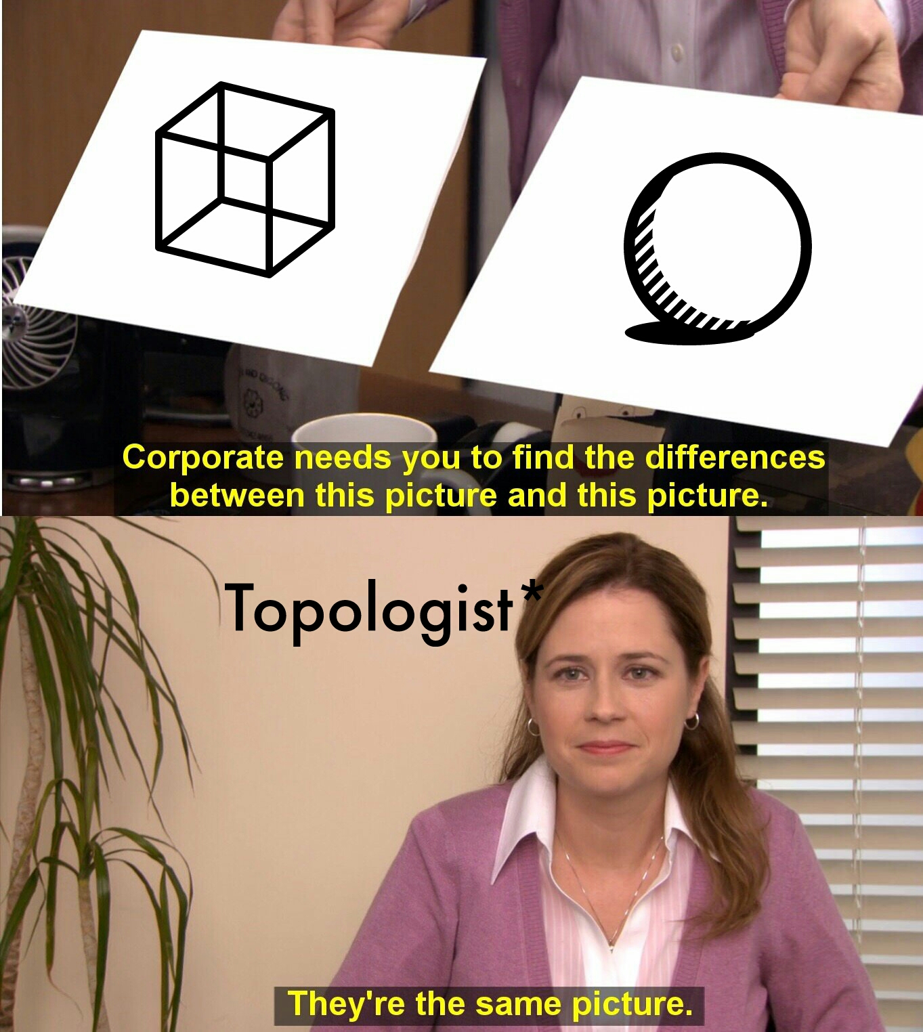
Topology
Topology is the study of shape of objects subject to smooth operations such as stretching and twisting but not tearing and gluing.
Topology tries to describe an object in more general terms like how many distinct components does an object have, how many holes on its surface, or how many cavities.

Slide 5
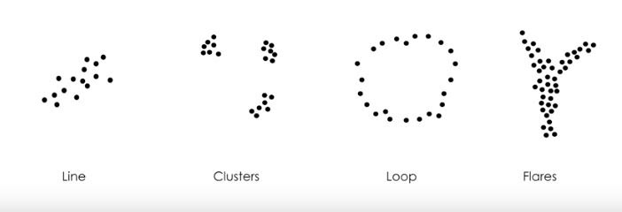
Shape of data
The shape of data often is associated with meaning.

Slide 6
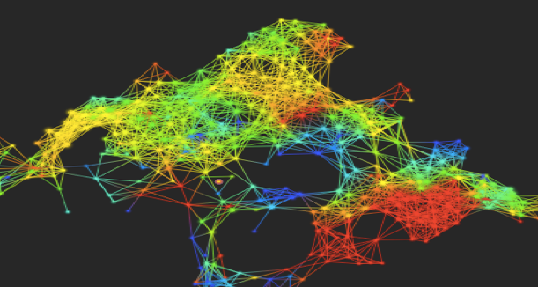
Topological Data Analysis
TDA attempts to determine topological features of data
Topological Data Analysis is the applications of the tools of topology to analyze datasets.
It is used to extract out the topological features of the data using tools like persistent homology.

Slide 7
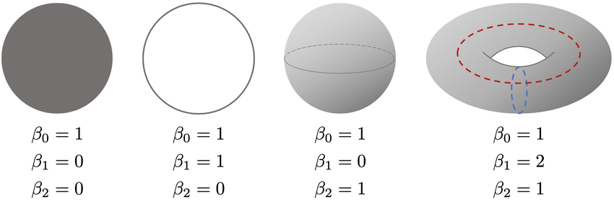
Topological Features
Betti Numbers are used to quantify topological features
b0 Is the number of connected components
b1 Is the number of one-dimensional or “circular” holes
b2 Is the number of two-dimensional “voids” or “cavities”

Slide 8
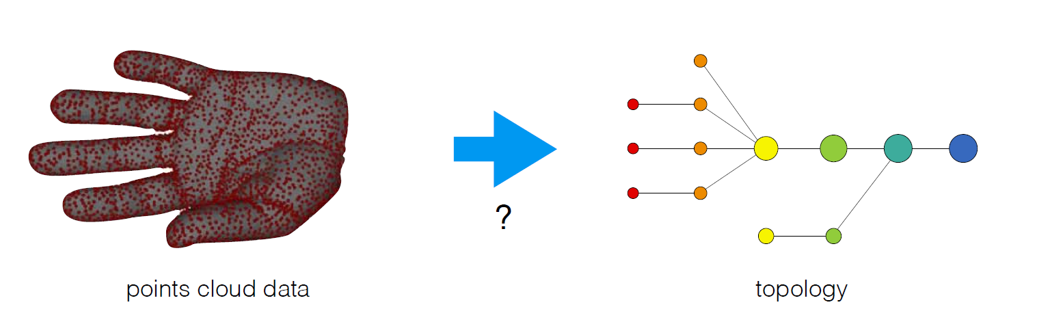
Filtration
Betti Numbers are calculated using Filtration based on the principles of persistent homology.
Different filtration functions are used for various datasets.

Slide 9
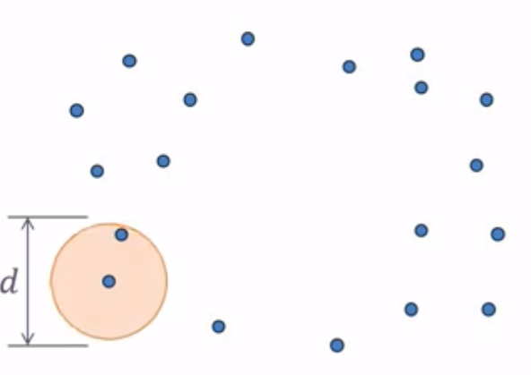
Rips Filtration
The Vietoris-Rips filtration is a versatile tool in topological data analysis.
It is a sequence of simplicial complexes built on a metric space to add topological structure to data. Otherwise disconnected set of point

Slide 10
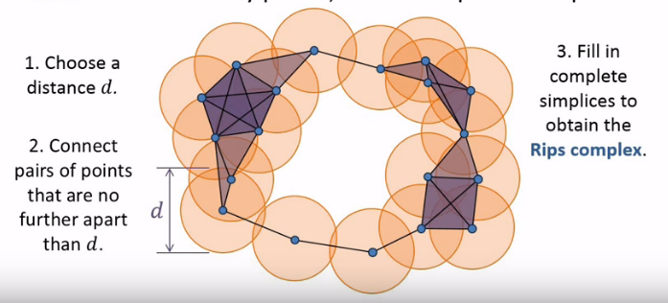
Rips Filtration

Slide 11
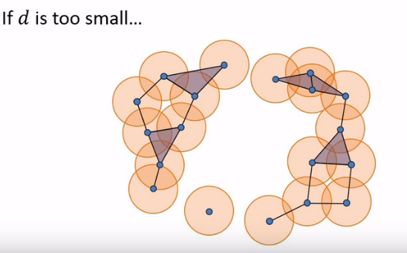
Rips Filtration
We have to ensure the holes that are made is significant. Not a noise for a particular d.

Slide 12
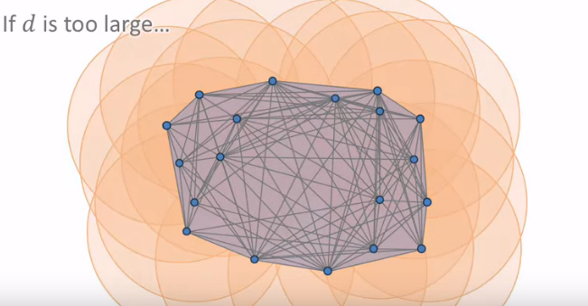
Rips Filtration
If d is too large, we get a giant simplex.(Trivial homology)

Slide 13
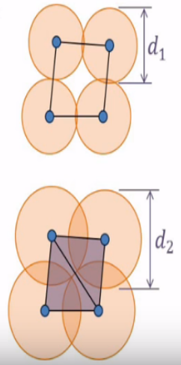
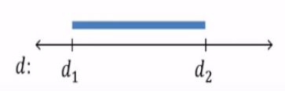
Persistence of features
Each hole appears at a particular value of d and disappears at another value of d.
We can represent the persistence of this hole as a pair (d1,d2).
We visualize this pair as a bar from d1 to d2.
The collection of bars creates a bar graph.

Slide 14
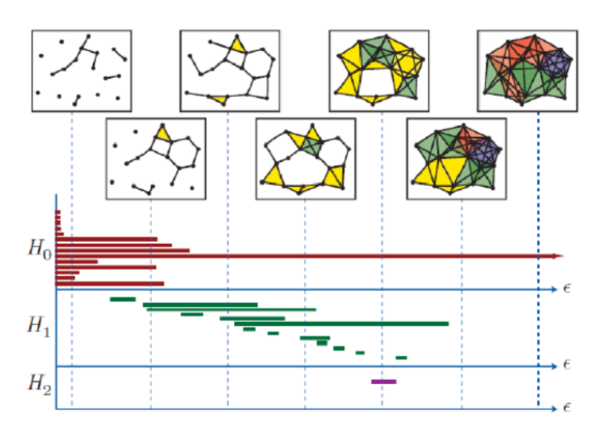
Persistence of features

Slide 15
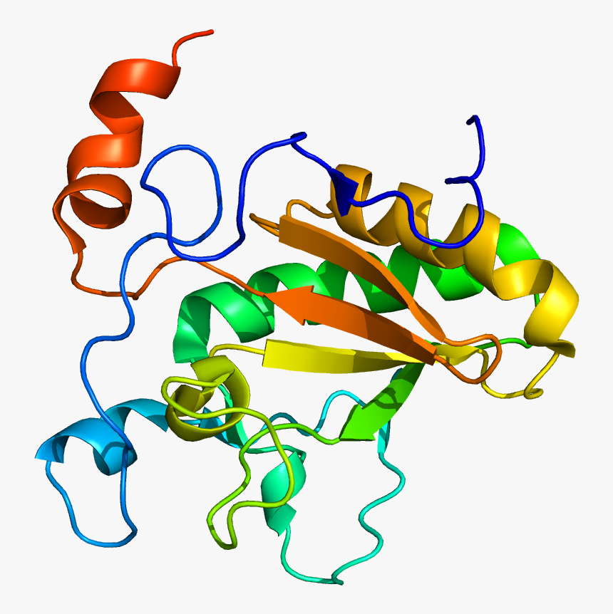
Topological Approach for Protein Classification
Influenza Chimeric Channel interaction with Rimantadine

Slide 16
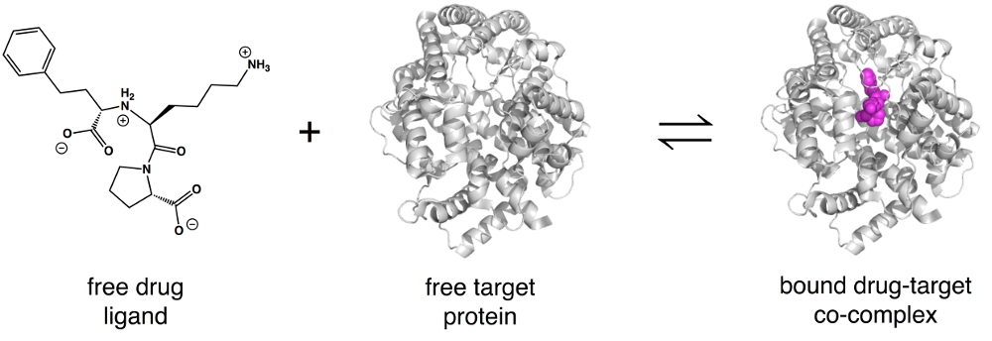
Molecular topological fingerprint (MTF) to reveal topology-function relationships in protein folding and protein flexibility. The objective of the present work is to explore the utility of MTFs for protein classification and analysis.
In many biological processes, protein may bind to other molecules.
After binding to other molecule, a protein usually experiences a structure change at the binding site.
We test our method for distinguishing proteins without drug use.

Slide 17
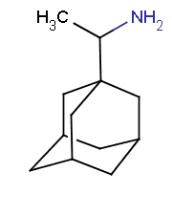
Biology
We use M2 channel, which is a transmembrane protein found in influenza A virus.
M2 channel plays a vital role in viral replication.
Therefore, it is used a target for the anti-influenza drugs.
The drug binding creates a topological change to the M2 channel in the conventional sense. Such a change is recorded in our MTFs and utilized for protein classification.
Rimantadine drug is tested as an anti-influenza drug

Slide 18
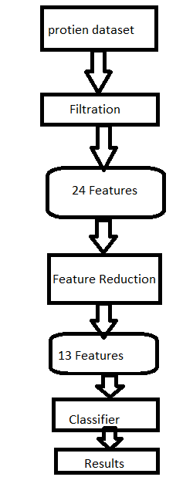
Algorithm
A protein structure can be represented as point cloud in three dimension for atoms or graph with edges corresponding to different types of chemical bonds. This geometric nature of protein structures allows the application of persistent homology.
We use Rips,Alpha and DTM filtration to extract
Topological features.
Essentially, we construct feature vectors by using MTFs.
We utilize the decision tree algorithm, which is known for its robustness and high accuracy

Slide 19
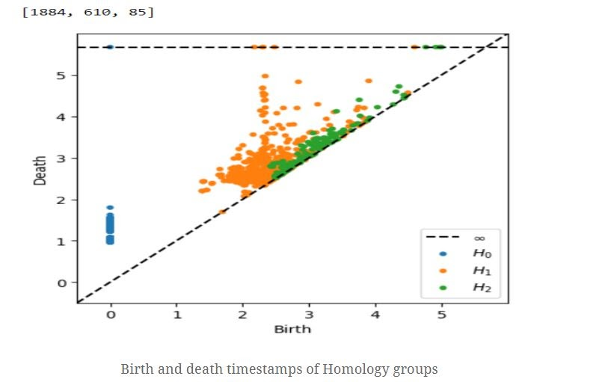
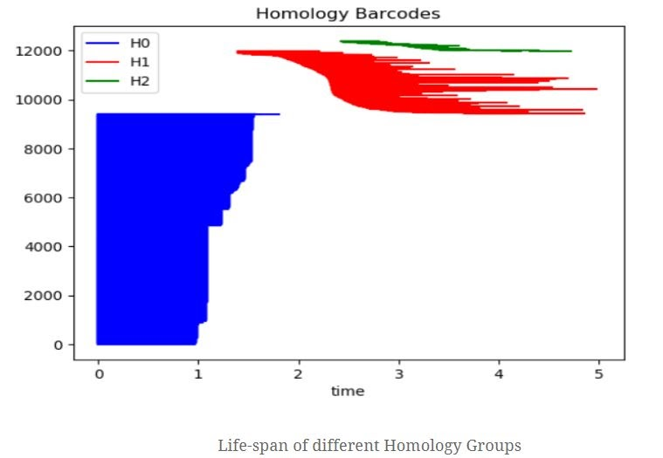
Topological Features

Slide 20
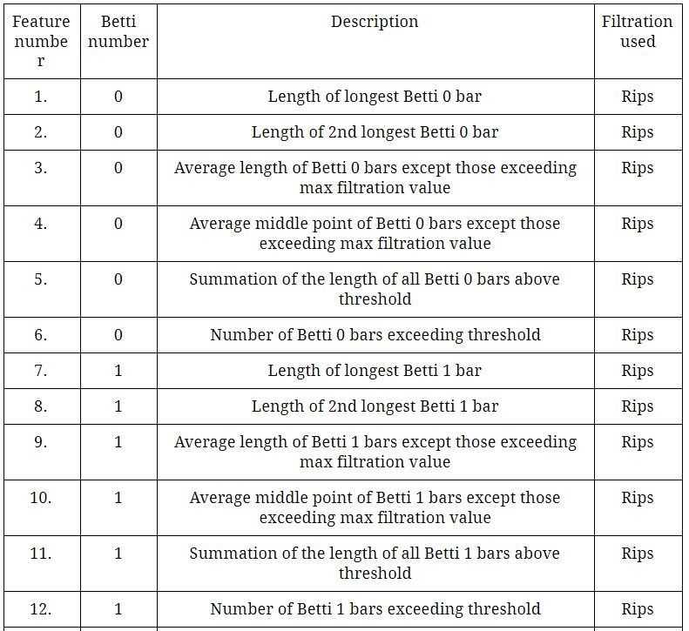
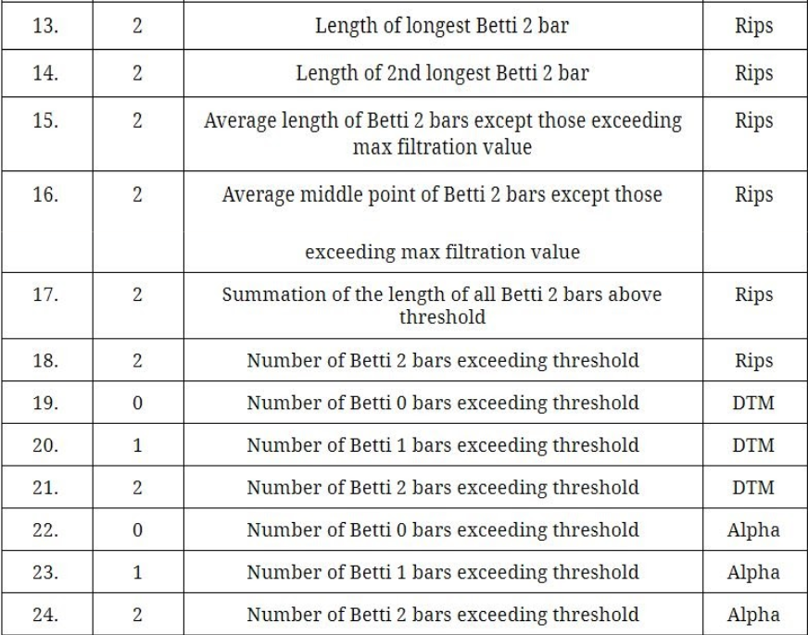
Topological Features

Slide 21
Feature Reduction Important Features
Pearson co-relation feature reduction
Algorithm is used.
To produce new feature space of essential Features.
13 most important
features are used for
Classification.
6.betti0 number
12.betti1 number
1.max bar length of betti0
6.2nd max bar length of betti1
13.max bar length of betti2
3.Average length of betti 0 bars except those exceeding max filtration value
9.Average length of betti 1 bars except those exceeding max filtration value
11. Summation of the length of all betti 1 bars above threshold
16.Average length of betti 2 bars except those exceeding max filtration value
17.Average middle point of betti 2 bars except those exceeding max filtration value
20.DTM-betti1 number
21.DTM betti2 number
23Alpha-betti2 number

Slide 22
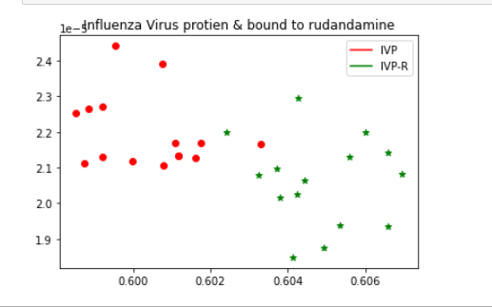
Results
Accuracy : 100% ( 5-fold cross-validation)
Decision tree classifier.
Precision : 100%
Feature Graph

Slide 23

COVID-19 PNEUMONIA DETECTION USING TOPOLOGY

Slide 24
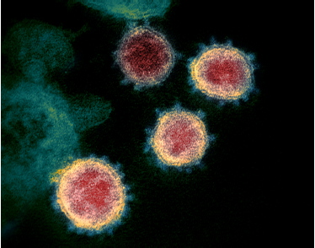
INTRODUCTION
COVID-19
Coronavirus disease 2019 (COVID-19) is an infectious disease caused by severe acute respiratory syndrome coronavirus 2 (SARS-CoV-2).
The lungs are the organs most affected by COVID‑19
PNEUMONIA
The new coronavirus causes severe inflammation in your lungs. It damages the cells and tissue that line the air sacs in your lungs. The lungs are the organs most affected by COVID‑19
This causes pneumonia which can be detected from X-rays

Slide 25
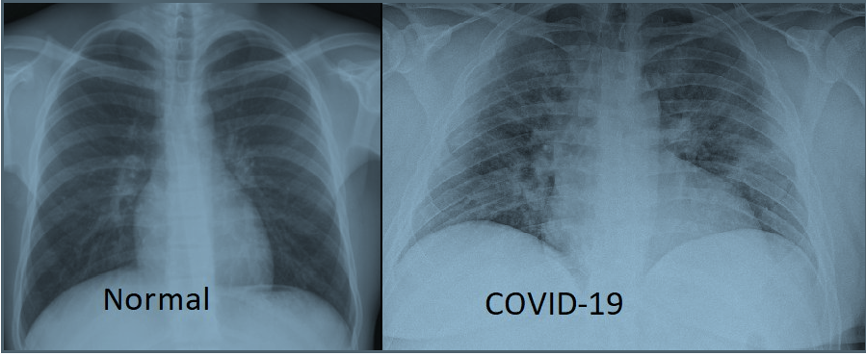
NORMAL LUNG V/S COVID-19 LUNG

Slide 26
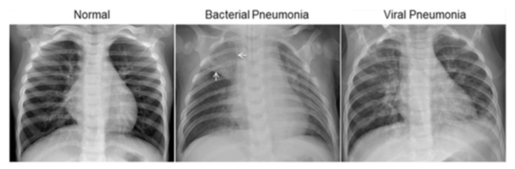
CLASSIFICATION OF PNEUMONIA

Slide 27

WHY USE TDA?
Topology helps detect large or small features in the data in the form of holes which is a powerful tool in detecting pathogenic pathways.
TDA works by extracting shapes (patterns) of data.
TDA does not depend on choice of metrics and provides stability against noise.

Slide 28
TDA MODEL
PROCEDURE USED TO CREATE MODEL

Slide 29
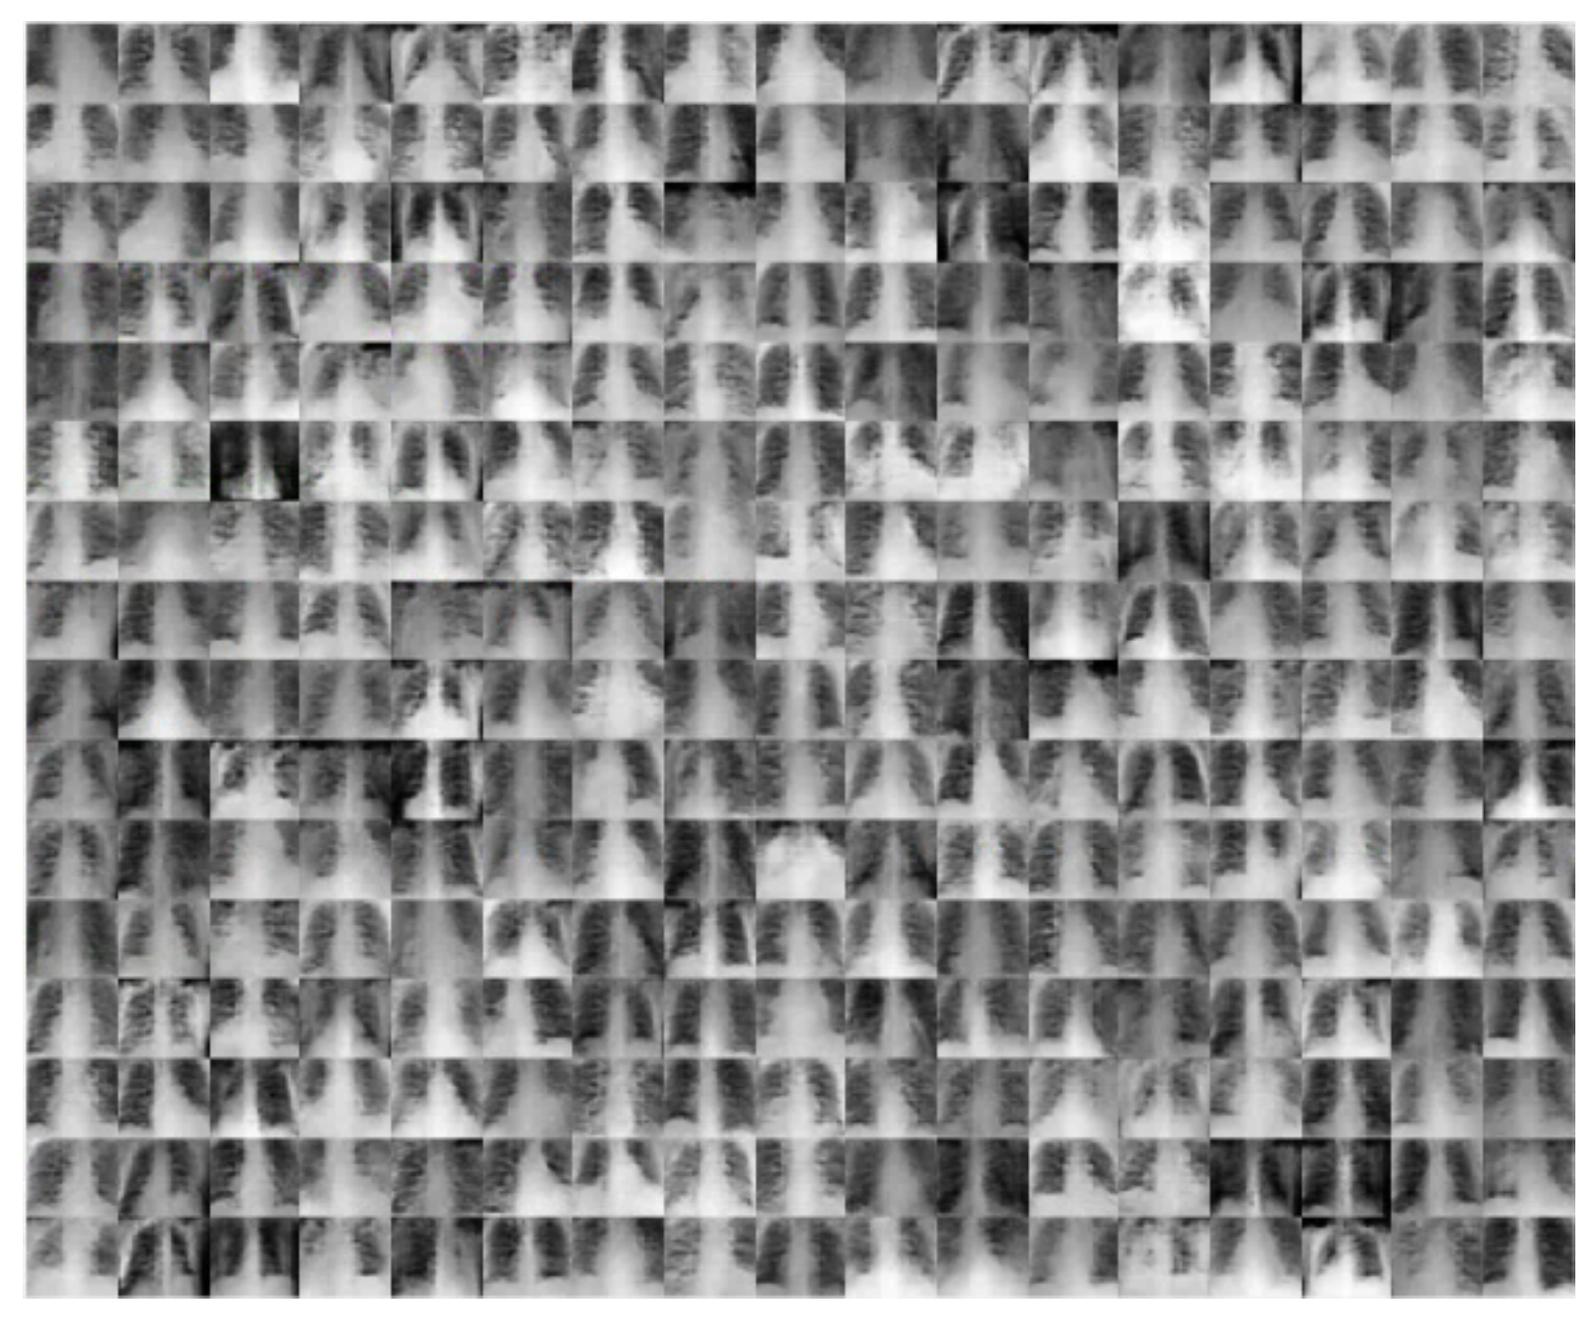
DATASET
X-ray images obtained from two different sources were used from British Society of Thoracic Imaging and Mendeley data.
There are 79 X-ray images
COVID-19 Pneumonia - 41
Bacterial Pneumonia - 39

Slide 30
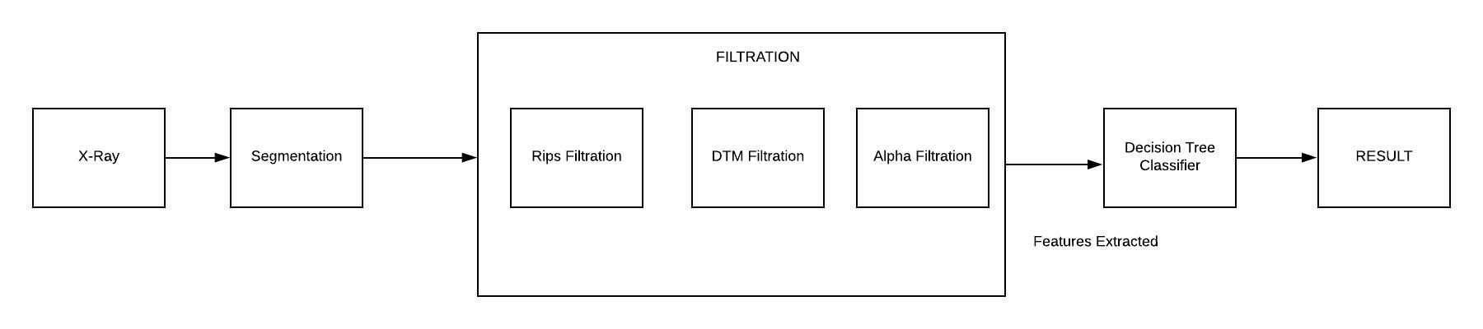
PIPELINE

Slide 31
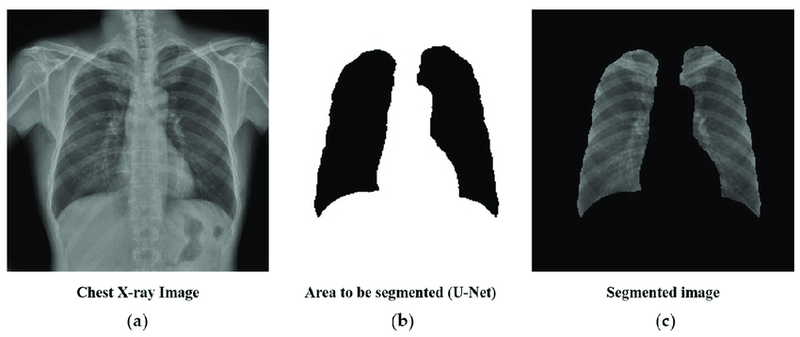
SEGMENTATION
Removes the unwanted part of the data

Slide 32
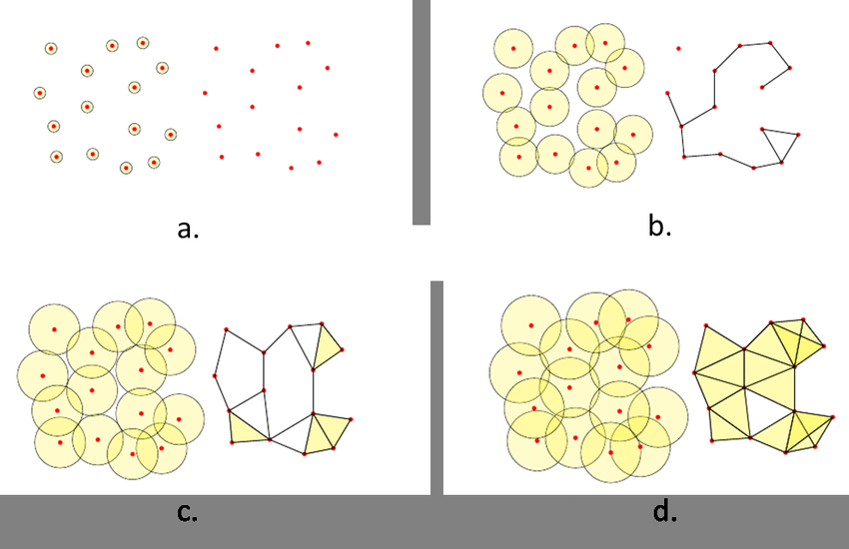
Rips Filtration
The Rips complex is an abstract simplicial complex defined on a finite metric space, where each simplex corresponds to a subset of points whose diameter is smaller than some given threshold.
The number of simplices in the full Rips complex is exponential in the number of vertices, it is thus usually restricted, by excluding all the simplices with filtration value larger than some threshold

Slide 33
Distance to Measure Filtration
Rips Filtration is susceptible to Noise.
X-rays contain noise due to metal parts on clothing.
Filtration defined by the sublevel sets of the distance-to-measure function(DTM) provided relevant information about the geometric structure underlying the data.
Using the uniform empirical measure on a set of points X. Given a probability measure P, The distance to measure function, for each y in R^d, is defined by
d_{m0}(y) = (1/m0 int_0^{m0} (G_y^{-1}(u))^{r} du)^{1/r},

Slide 34
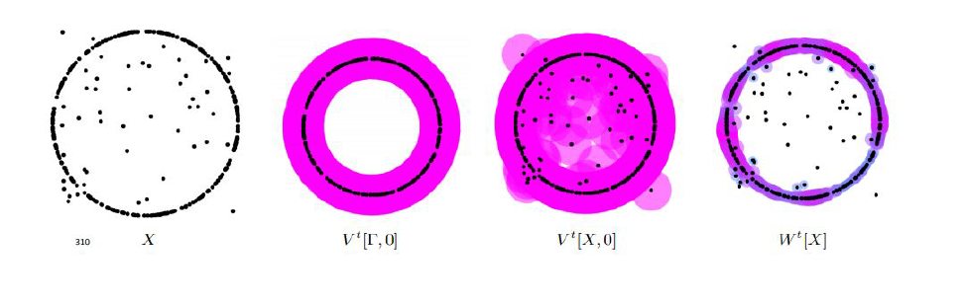
DTM Filtration

Slide 35
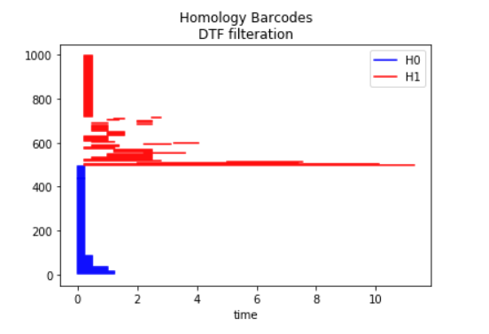
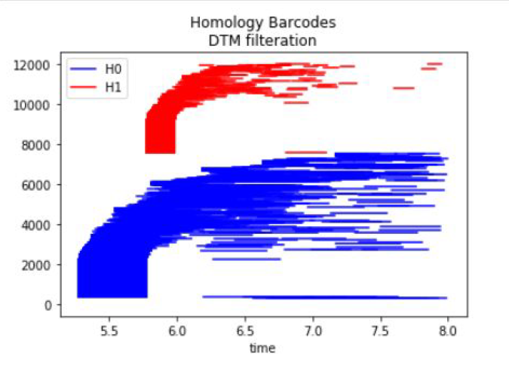
DTM
Bacterial Pneumonia
COVID-19 Pneumonia

Slide 36
α Filtration
α-complex is a simplicial complex constructed from the finite cells of a Delaunay Triangulation.
Rips uses circles and α-complex uses triangles.
The filtration value of each simplex is computed as the square of the circumradius of the simplex.
All simplices that have a filtration value >α are removed from the Delaunay complex when creating the simplicial complex if it is specified

Slide 37
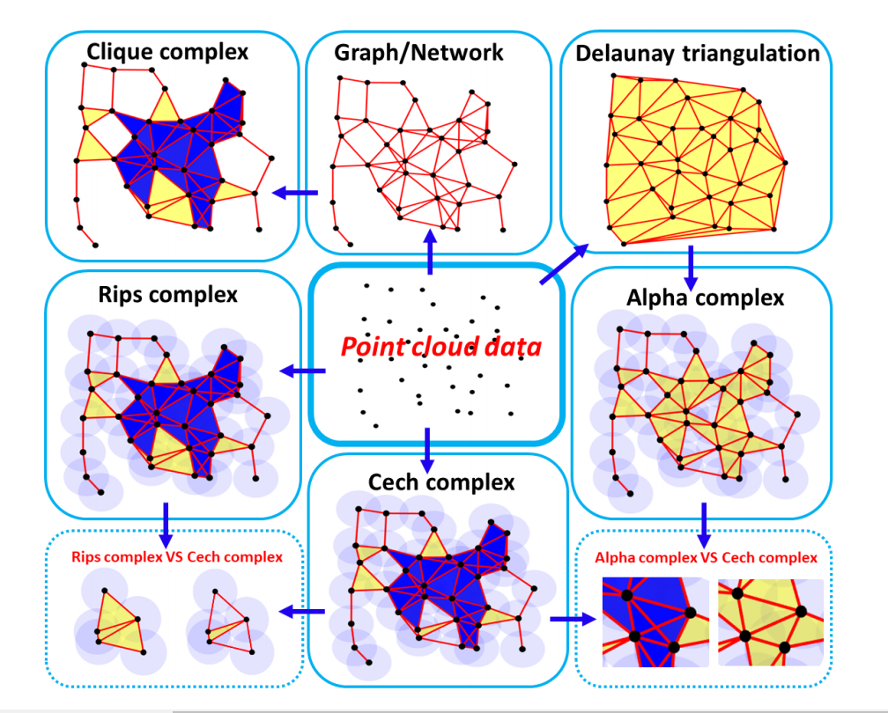
WORKING

Slide 38
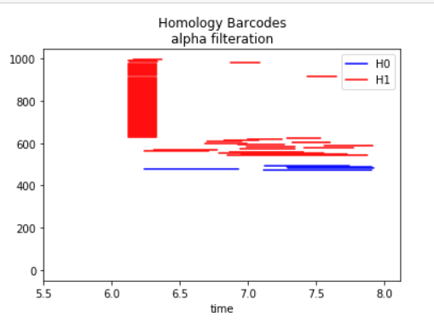
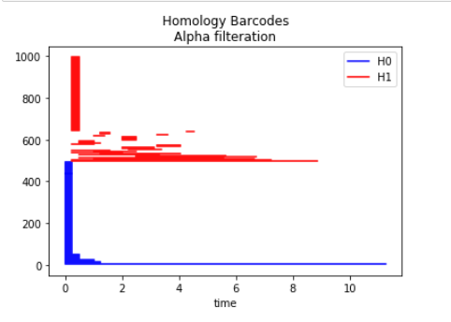
α Filtration
Bacterial Pneumonia
COVID-19 Pneumonia

Slide 39
Features Extracted
6 features are extracted using 3 filtrations.
α Filtration : (b0,b1)
Rips Filtration : (b0,b1)
DTM Filtration : (b0,b1)
Feature Number | Filtration method
1 – b0 | Rips Filtration
2 – b1 | Rips Filtration
3 – b0 | DTM Filtration
4 – b1 | DTM Filtration
5 – b0 | α-Filtration
6 – b1 | α-Filtration

Slide 40
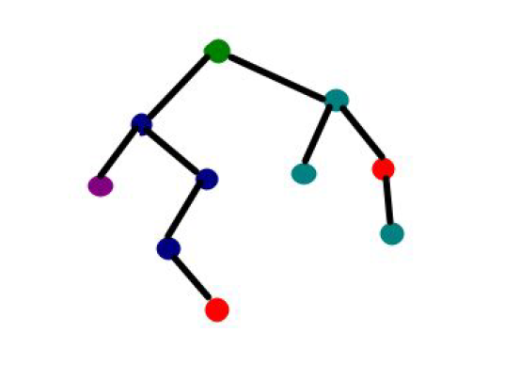
Decision Tree Classifier
Once the features are extracted decision tree algorithm is used to classify the data.
It is a Supervised Machine Learning where the data is continuously split according to a certain parameter.
Using the decision algorithm, we start at the tree root and split the data on the feature that results in the largest information gain (IG)

Slide 41
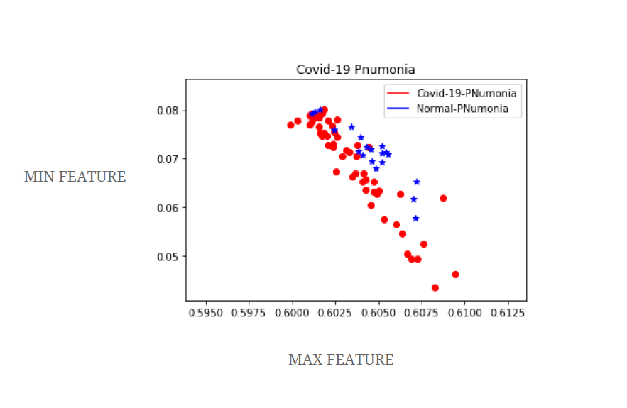
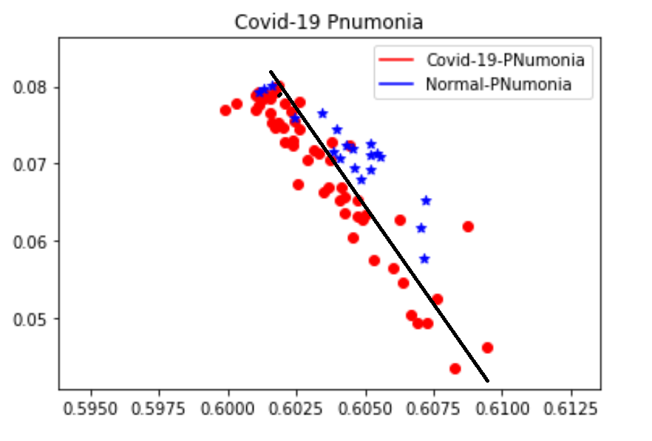
COVID-19 FEATURE GRAPH

Slide 42
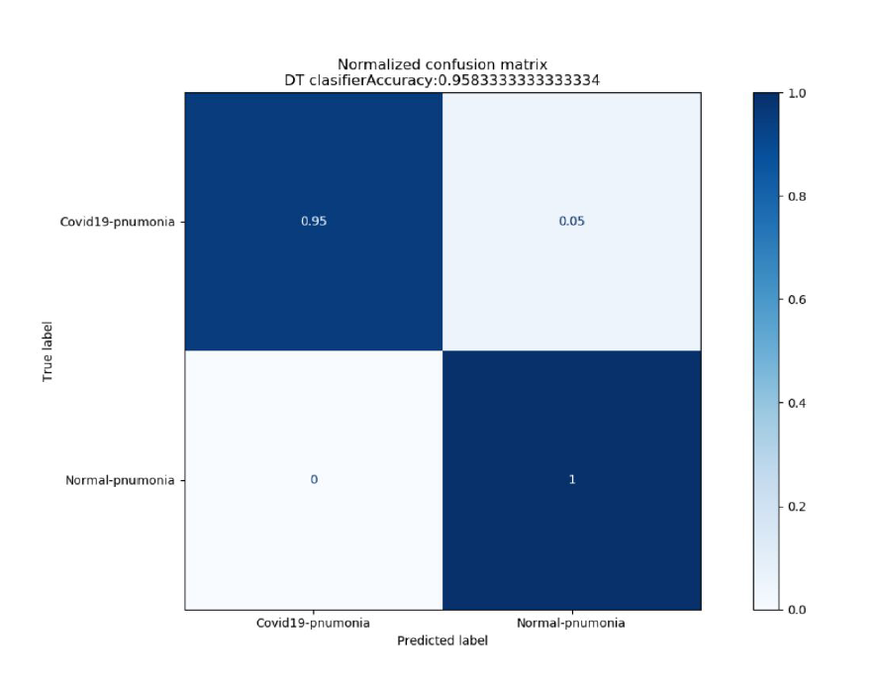
RESULTS

Slide 43


Results
Accuracy = 95.84%
Precision = 95%

Slide 44
CREDITS
Project Guide : Prof. Apurba Sarkar
Reference materiel : Gudhi, Research Gate, Wikipedia, Analytics Insights, Scikit-TDA
Team : Shivaditya, Chandrapal, Kaushik, Ronak and Mohanee

Slide 45
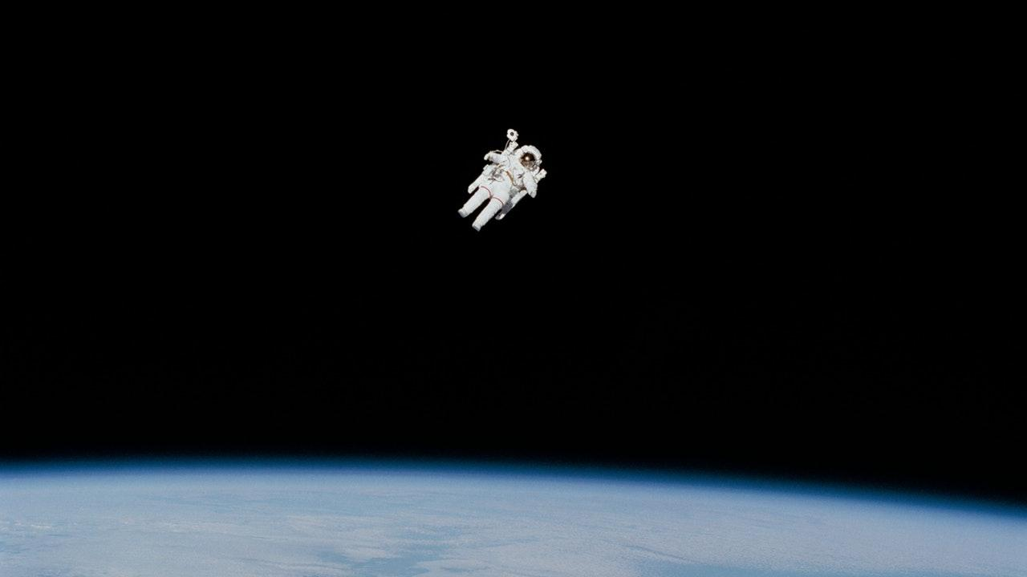
THANK YOU!

